Slide 1
Debugging

Slide 2
Debugging
Debugging is a technique by which we can find the error, correct the error and detect the error.
SAP debugger is a part of ABAP workbench only.

Slide 3
Ways of Debugging
There are 2 ways of debugging.
Set the breakpoint on any executable statement and program stops automatically at that point.
We can debug the code with the help of transaction code /h.

Slide 4
Execution Keys
There are 4 execution keys in debugging mode.
F5 - Step by step execution
F6- Line by line execution
F7 - Return
F8 - Continuous execution or exit

Slide 5
System Variables
There are 2 default system variables available in the debugging mode.
SY-SUBRC - System variable for return code(successful = 0, not successful = other than 0).
SY-TABIX - It returns the current line index inside a loop.

Slide 6
Static Breakpoints
Static breakpoints are also called as user independent breakpoints.
The syntax to set a static breakpoint is BREAK-POINT.

Slide 7
Dynamic Breakpoints
Dynamic breakpoints are also called as user dependent breakpoints.
The syntax to set a dynamic breakpoint is BREAK username.

Slide 8
Operations on Internal Table
The various operations on internal table in the debugging mode are as follows:
Deleting a row from an internal table.
Editing a row of an internal table.
Adding a row to an internal table.
Saving internal table to a local file.
Delete complete table.

Slide 9
Features - Goto Statement
We can jump to a particular statement in debugging mode by using the path :
Debugger-Goto statement.
We can also jump to a particular statement by using the shortcut ‘Shift + F12’.

Slide 10
Features - Setting Breakpoint at Keywords , FM’s and Messages
We can set the breakpoints at keywords in debugging mode like - SELECT, CALL FUNCTION, MESSAGE etc.
We can also set breakpoints on specific function modules or subroutines or messages etc.

Slide 11
Features - Deleting and Deactivating the Breakpoints
Deleting breakpoints - Permanently deleting the breakpoints in that particular session.
Deactivating breakpoints - Temporary deleting the breakpoints in that particular session. When we run the program again, the breakpoint resumes.

Slide 12
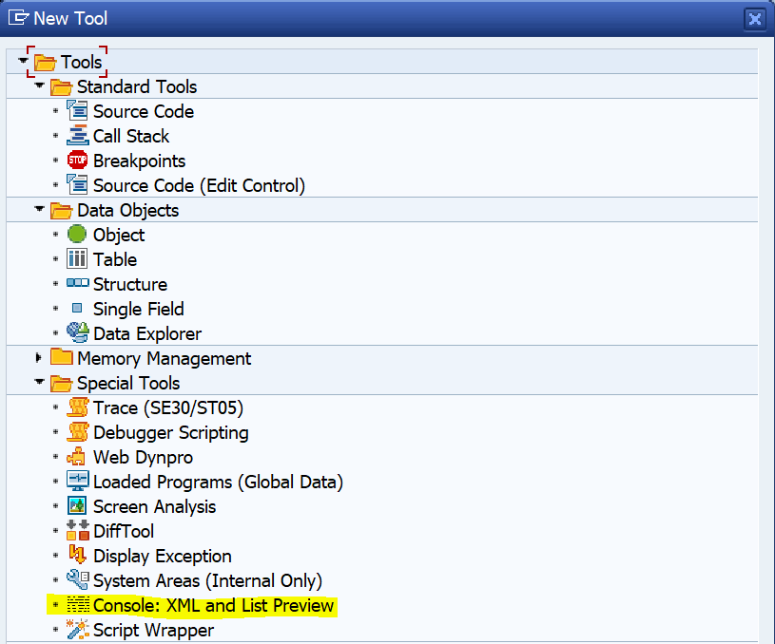
Features - List Preview
In the debugging mode, we can check the
preview of the list output.
The path to check the list preview is as follows:
New Tool - Special Tools - Console : XML and
List Preview

Slide 13
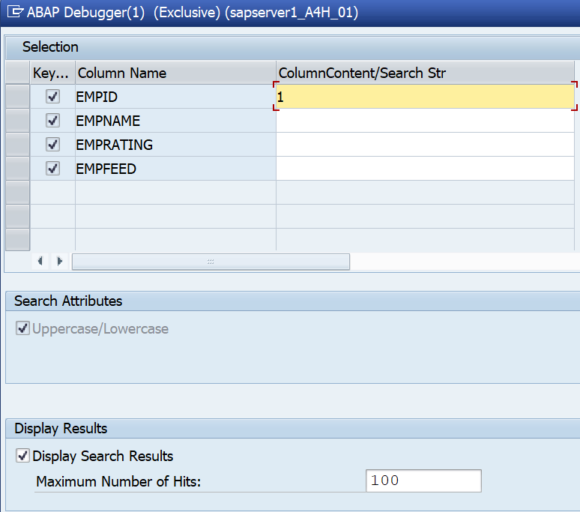
Features - Find
In the debugging mode, we can find the
specific records of internal table.
We need to do CTRL + F for the internal table
data, one pop-up appears to pass the column
values, pass the input and it point to the
records having matching values.

Slide 14
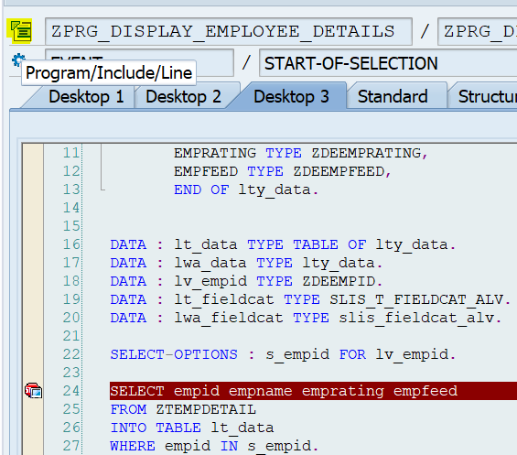
Features - Source Code Display
In the debugging mode, we can open the code
in a new session without closing the debugging
session.
We need to click on to program/include/line
icon as per the screenshot(highlighted).

Slide 15
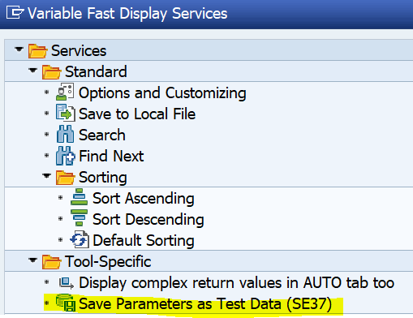
Features - Save Parameters as Test Data(SE37)
We can save the function module parameter
values in the debugging mode.
The path to save function module parameters
values as test data is as follows:
Services of the Tool - Save Parameters as Test Data(SE37)
Notes:
s

Slide 16
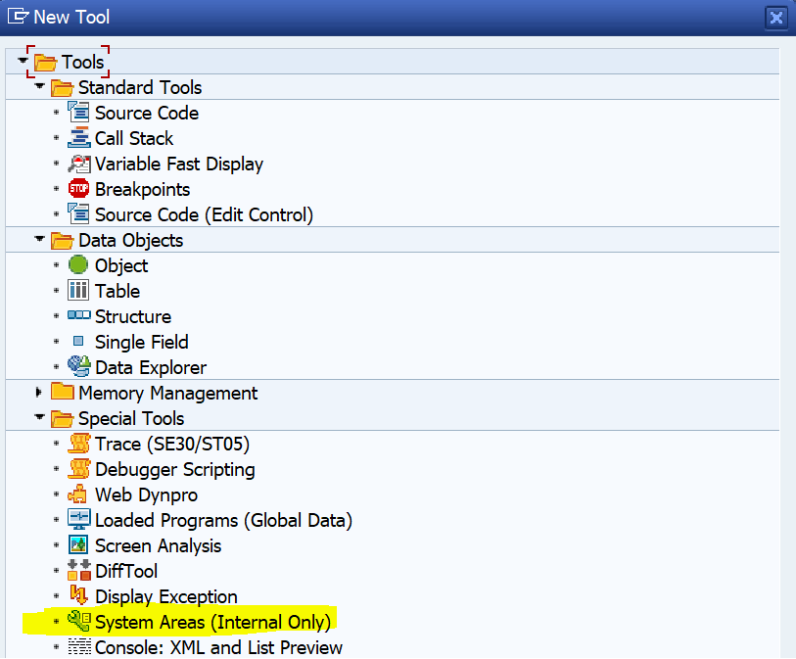
Features - SAP Memory and ABAP Memory Values
We can check the values of SAP memory
and ABAP memory in the debugging mode.
The path to check the memory id values in the
debugging mode is as follows:
New Tool - Special Tools - System Areas
(Internal Only)
Notes:
s

Slide 17
Watchpoints
Watchpoints are used to monitor the values of variables, workareas and internal tables.

Slide 18
Breakpoints and Watchpoints Comparison
Breakpoints are for executable statements whereas watchpoints are used to monitor the values of variables, work areas and internal tables.
A user can set a maximum of 30 breakpoints whereas a user can set a maximum of 10 watchpoints.

Slide 19
Comparison of Session Breakpoint and External Breakpoint
A session breakpoint is attached to user session and exists until the user closes the last session, whereas external breakpoint has a validity of 2 hours.
The icon of session breakpoint looks like a computer monitor set in front of a stop sign whereas the icon of external breakpoint looks like a person set in front of a stop sign.
The session breakpoint is used to debug the ABAP code internally whereas the external breakpoint is used to debug the ABAP code from an external process like Web Dynpro applications, BSP(Business Server Pages) etc.

Slide 20
User Specific Desktop
Desktop 1, Desktop 2 and Desktop 3 are considered as user specific desktop in the debugging mode.

Slide 21
Way to Debug a Dialog Screen or Pop Up Screen
Firstly, we need to create a text document using the below mentioned code.
[Function]
Command=/H
Type=SystemCommand
Then drag and drop this text document on the required dialog screen or pop up screen.

Slide 22
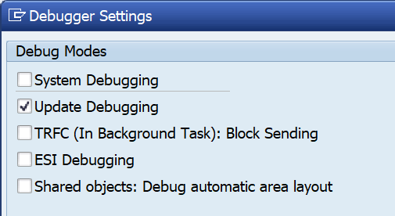
Update Debugging
Update debugging is used to debug the
code which is written in the update task
as we can not debug the update task code
using normal debugging.
Example - Function module called in the update task.
The path to on the update debugging is as follows :
Settings - Change Debugger Profile/Settings - Update Debugging

Slide 23
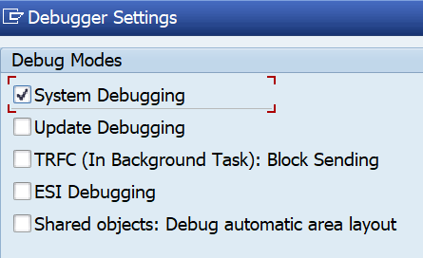
System Debugging
System debugging is used to debug the code of system programs.
The path to check a system program is as follows:
Goto - Attributes - Status( S = system program).
The path to on the system debugging is as follows :
Settings - Change Debugger Profile/Settings - System Debugging

Slide 24
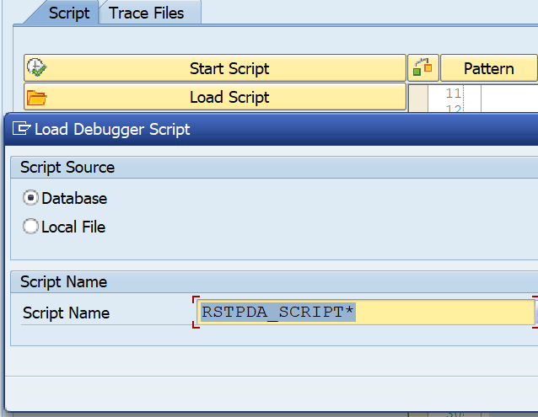
Script Tab
We can use the script tab to stop
the debugger on the selection of specific
tables and update of tables.
We need to go to script tab, click on to
load script and pass the name of the script
as per the requirement.

Slide 25
Script Tab(Contd.)
The various scripts for selection and updating of tables are as follows:
Script for selection of tables - RSTPDA_SCRIPT_BP_SELECT_TAB
Script for updating of tables - RSTPDA_SCRIPT_BP_CHANGE_TAB

Slide 26
Thank You

